Slide 1

BHAAV VAACHAK
Abhijeet
Abhilash Sharma
Aditya Agarwal
Team- Abstract Executioners
Moradabad Institute of Technology
B.Tech, 2024 (CS&E)
3rd year, Section A
22-November-2022

Slide 2


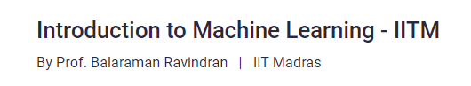


Moradabad Institute of Technology (B.Tech CSE,2024)
Based on course:

Slide 3





Slide 4
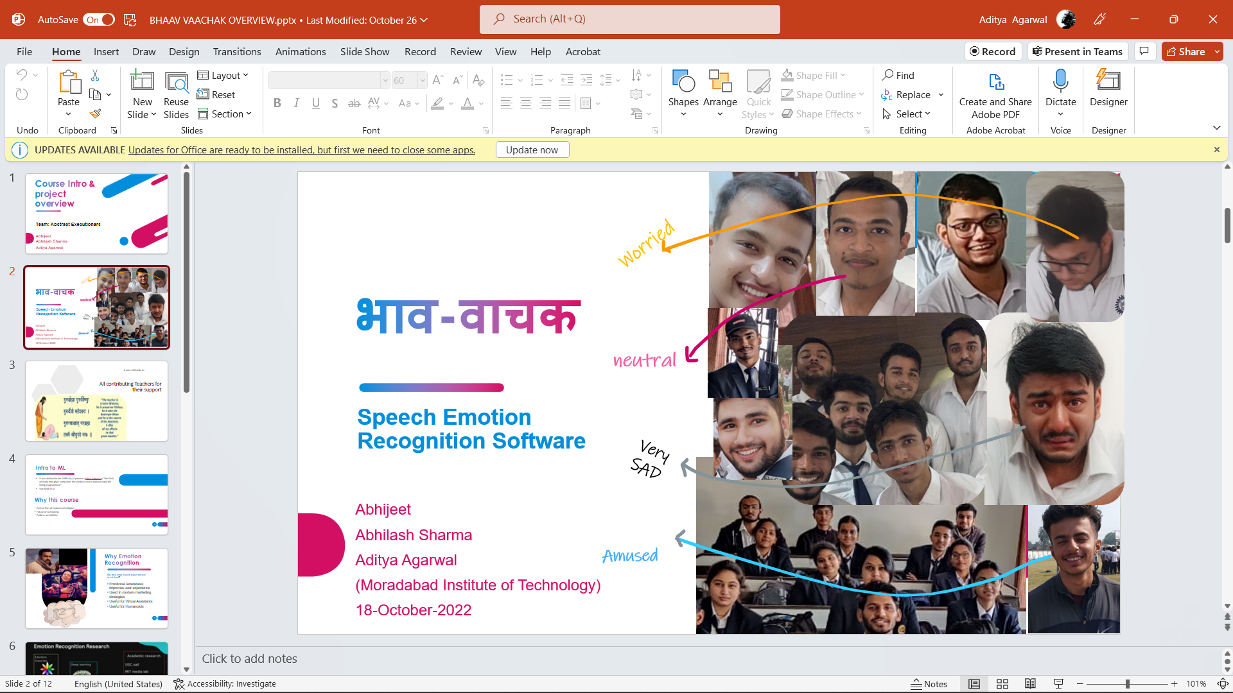
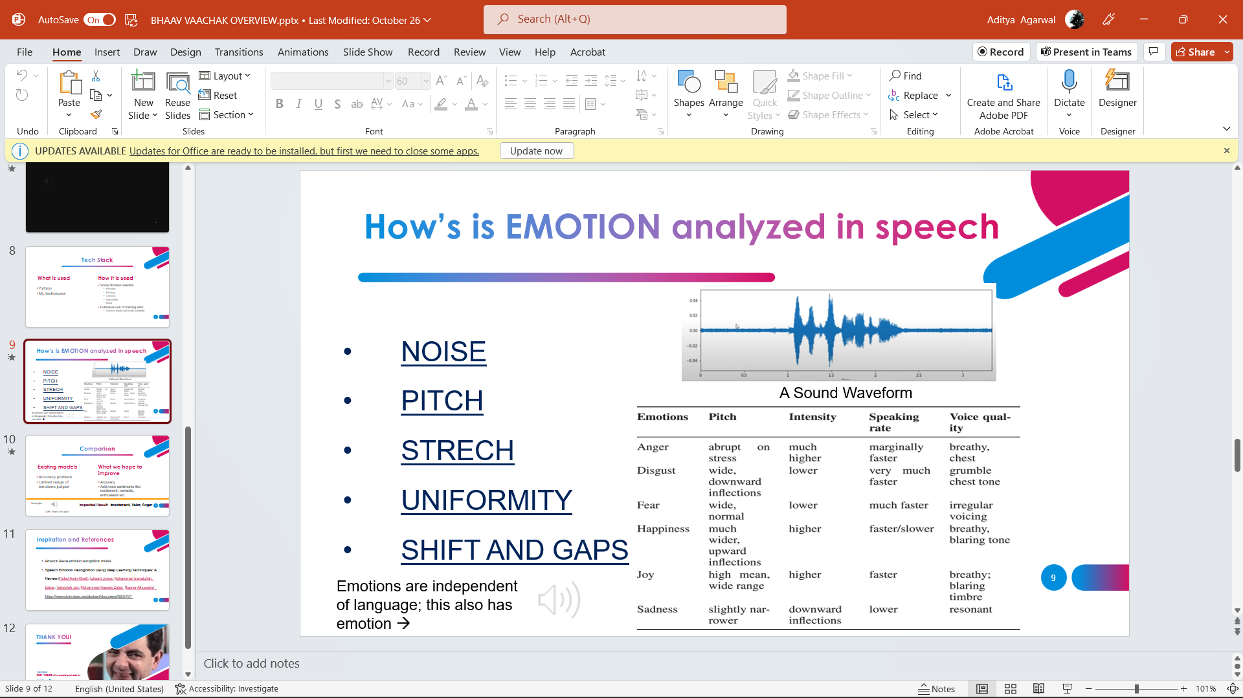
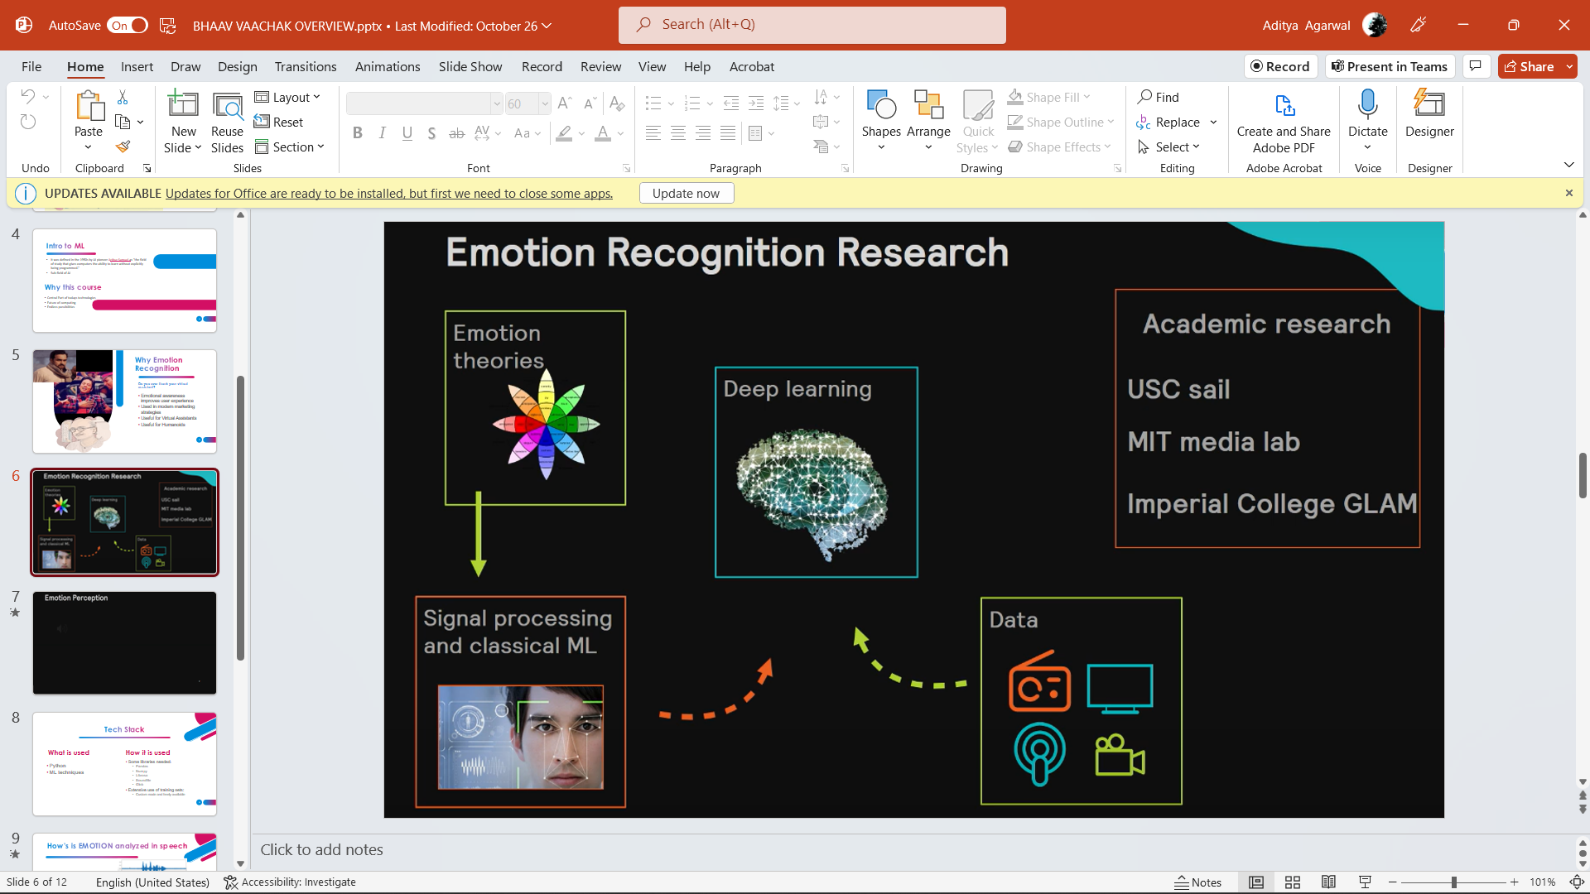
What we covered in overview
Introduction
Methodology
Applications
Examples

Slide 5
Machine Learning Techniques used:
Supervised Learning
MultiClass Classification
Convolutional Neural Network
Sequential Modelling

Slide 6
Dataset used:
RAVDESS
Attribution: The Ryerson Audio-Visual Database of Emotional Speech and Song (RAVDESS) by Livingstone & Russo is licensed under CC BY-NA-SC 4.0

Slide 7
About the dataset
RAVDESS contains 1440 files: 60 trials per actor x 24 actors = 1440. The RAVDESS contains 24 professional actors (12 female, 12 male), vocalizing two lexically-matched statements in a neutral North American accent. Speech emotions includes calm, happy, sad, angry, fearful, surprise, and disgust expressions. Each expression is produced at two levels of emotional intensity (normal, strong), with an additional neutral expression.
File naming convention
Each of the 1440 files has a unique filename. The filename consists of a 7-part numerical identifier (e.g., 03-01-06-01-02-01-12.wav). These identifiers define the stimulus characteristics:
Filename identifiers
Modality (01 = full-AV, 02 = video-only, 03 = audio-only).
Vocal channel (01 = speech, 02 = song).
Emotion (01 = neutral, 02 = calm, 03 = happy, 04 = sad, 05 = angry, 06 = fearful, 07 = disgust, 08 = surprised).
Emotional intensity (01 = normal, 02 = strong). NOTE: There is no strong intensity for the 'neutral' emotion.
Statement (01 = "Kids are talking by the door", 02 = "Dogs are sitting by the door").
Repetition (01 = 1st repetition, 02 = 2nd repetition).
Actor (01 to 24. Odd numbered actors are male, even numbered actors are female).

Slide 8
About the dataset:
Filename example: 03-01-06-01-02-01-12.wav
Audio-only (03)
Speech (01)
Fearful (06)
Normal intensity (01)
Statement "dogs" (02)
1st Repetition (01)
12th Actor (12) Female, as the actor ID number is even

Slide 9
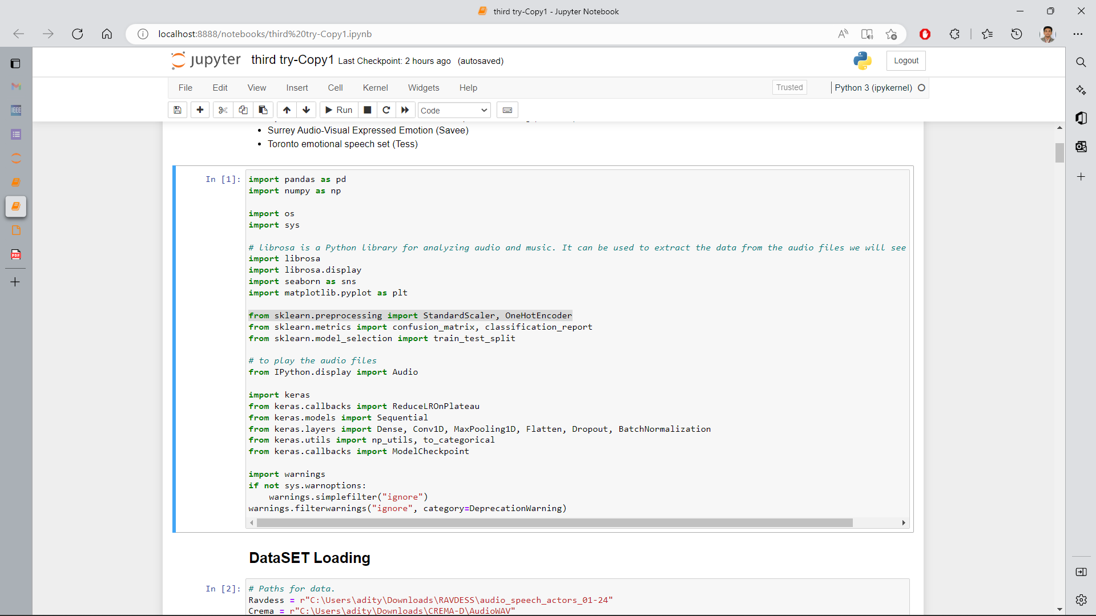
Libraries/Modules used:
For Audio Handling
Librosa
Ipython
For Data Handling & ML implementation:
Keras
Sklearn
Numpy
Pandas

Slide 10
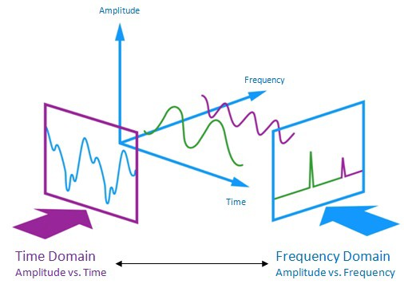
How are we analyzing audio
Feature Extraction
Zero Crossing Rate
Chroma_stft
MFCC
RMS(root mean square) value
MelSpectogram

Slide 11
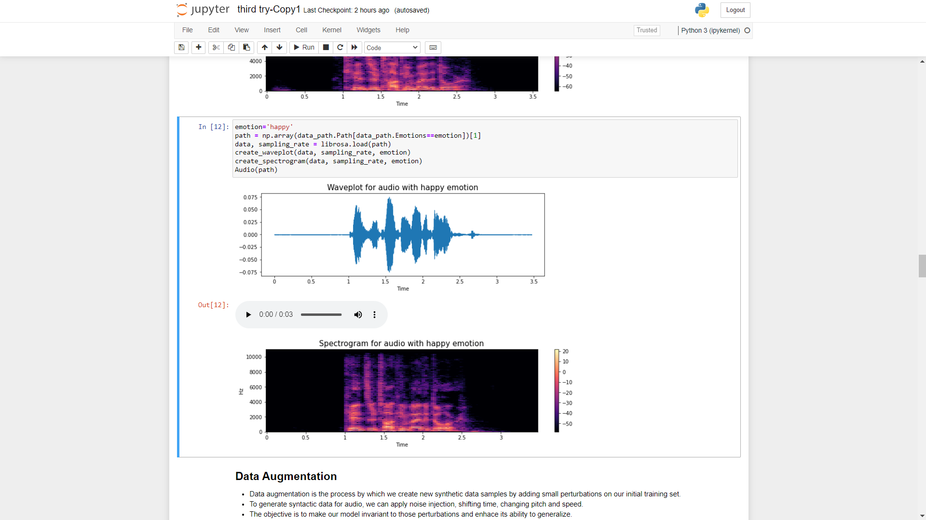
How are we analyzing audio

Slide 12
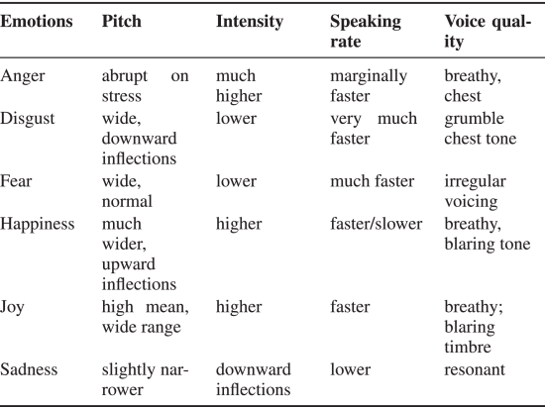
Emotion theory used:

Slide 13
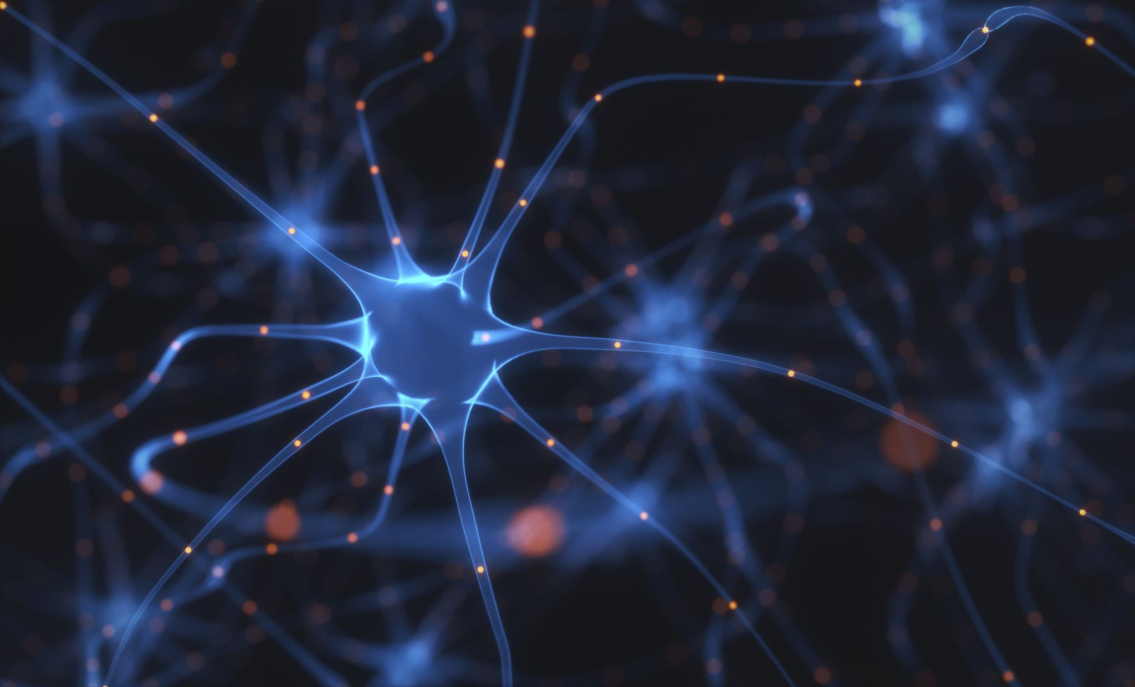

Convolutional Neural Network
Class of artificial neural network
Learns directly from data, eliminating the need for manual feature extraction

Slide 14
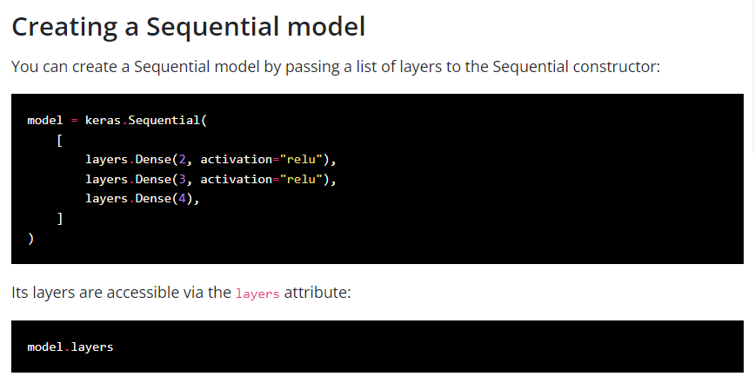
The Sequential model
A CNN can be instantiated as a Sequential model because each layer has exactly one input and output and is stacked together to form the entire network.

Slide 15
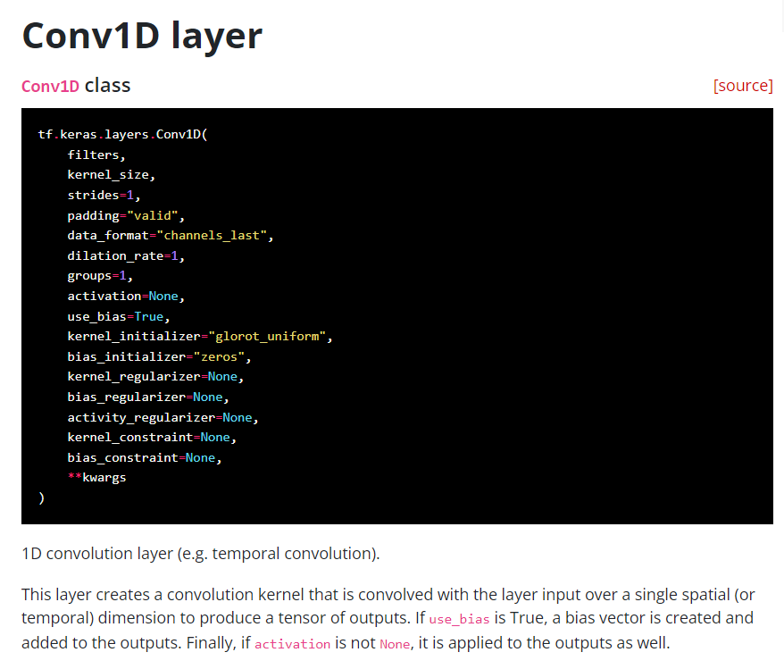
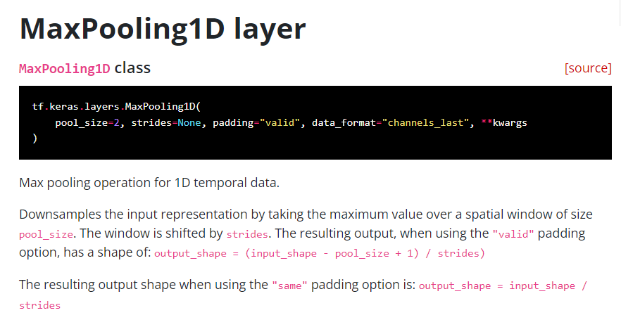
Layers used in our CNN

Slide 16
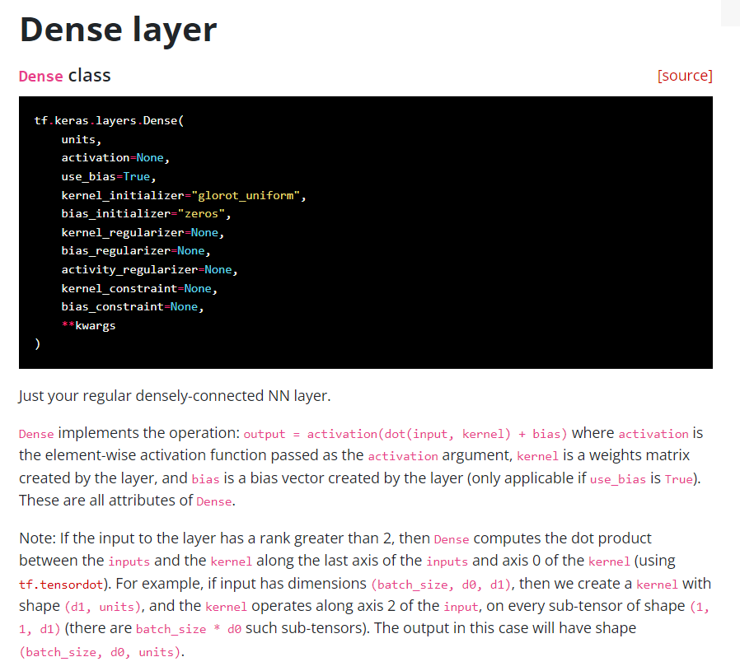
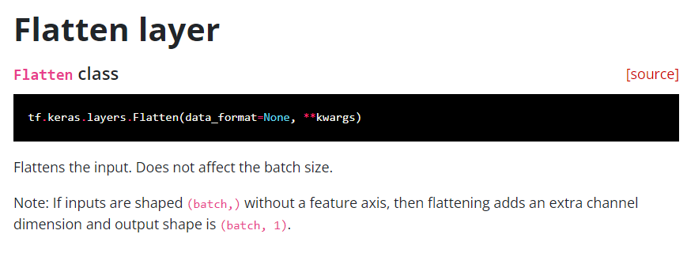
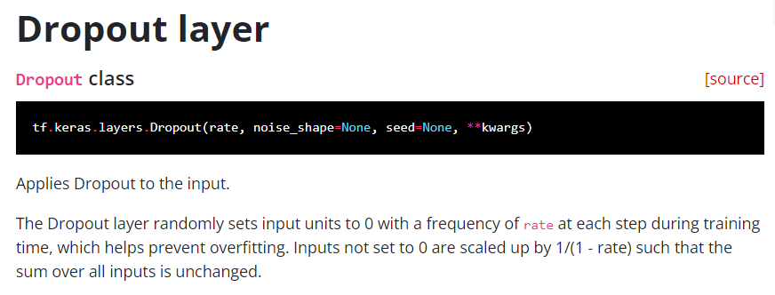
Layers used in out CNN

Slide 17
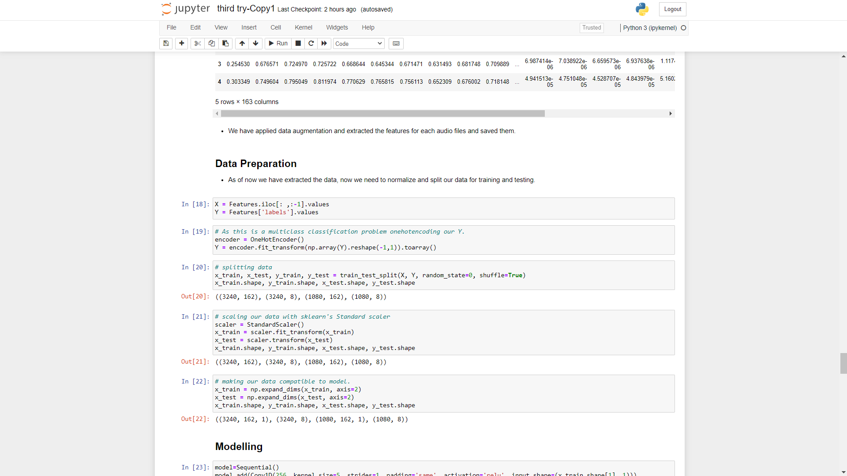
Preparing data for the model

Slide 18
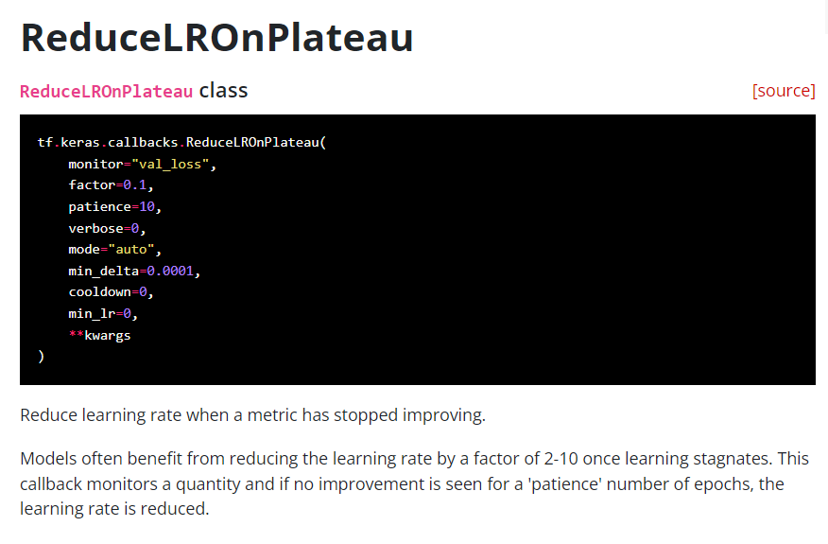
Controlling the learning rate :

Slide 19
Demonstration of the model using RAVDESS dataset →

